Slide 1

job hiring Portal database design
EDS6397 – DATABASE MANAGEMENT TOOLS

Slide 2





INTRODUCTION
Our primary goal is to create a comprehensive web-based Job Hiring Platform
To reduce the gap between job seekers and employers.
Enables seamless job searches, streamline the application process, and allow employers to manage their hiring needs effectively.
Catering to two primary user roles:
Job Seeker :- Individuals seeking employment opportunities.
Employer:- Companies and organizations posting job listings.
Technology stack: PHP, HTML, CSS, JavaScript, Visual Studio code editor, MySQL server & Database, XAMPP.

Slide 3


Design Architecture & Workflow
Database Design
Organized Entities
Logical ERD
Relational Constrains
Data CRUD
User Interface Design
UL Style and format
Logical Service path
Query integration
Bug fixing
Server Design
Tech Stack integration
Query Deployment
Page Management & Navigation

Slide 4
Database Design – Business Rules
1. User Registration and Authentication:
All users must provide a valid email address during registration, and email addresses must be unique across the system.
Passwords must adhere to a secure password policy, including a minimum length and a combination of alphanumeric characters.
2. Academic Qualifications:
Each academic qualification entry must be associated with a valid member ID, ensuring that qualifications are correctly linked to individual members. But each member could have many academic qualifications.
The timeframe for academic qualifications should reflect the period during which the qualification was obtained.
3. Professional Experience:
Professional experience entries must be linked to a valid member ID, establishing a clear connection between the experience and the member's profile. But each member could have many Professional Experiences.
Start dates for professional experience must precede or be equal to end dates, ensuring logical and consistent date ranges.
4. Job Listings:
Each job listing must have a unique job ID to distinguish it from other listings.
Each job could receive many applications but only one application can be posted to a job by a member
5. Language Proficiency:
Language proficiency entries must be associated with a valid member ID, connecting language skills to specific members. Each Person can speak many languages

Slide 5
Business Rules (Cont.)
6. Referees:
Referee entries must be unique and linked to a valid member ID, establishing a clear connection between referees and the members they are associated with.
Each member could have multiple references and referred entity does not collide with users
7. User Roles:
3 User roles (e.g., employee, employer) must be assigned based on user registration information and are used to control access to specific features.
8. Alerts:
Alert codes and types must follow a predefined set of values, ensuring consistency and facilitating effective communication through alerts. Only purpose of this entity is to have a smooth UI.
9. Tokens:
Each token must be associated with a valid email address, linking tokens to specific users for authentication purposes.
Tokens should have a limited validity period to enhance security.
10. Training:
Training entries must be linked to a valid member ID, connecting training records to specific members.
The timeframe for training should accurately reflect the period during which the training occurred.
Each member could have undergone many training sessions.

Slide 6
Business Rules (Cont.)
11. Other Attachments:
Other attachments must be associated with a valid member ID, ensuring that supplementary materials are correctly linked to individual member profiles. Attachment titles should follow a standardized naming convention for easy identification.
Each member could have many attachments .
12.Professional Qualifications:
Professional qualification entries must be linked to a valid member ID, establishing a clear connection between qualifications and the members they belong to. But each member could have many Professional qualifications.
The timeframe for professional qualifications should accurately reflect the period during which the qualification was obtained.
13. Categories:
Categories must have unique category names to avoid ambiguity and ensure a clear classification system.
Category IDs must be unique, serving as distinct identifiers for each category.
Many jobs could be posted for the same category.
14. Countries:
Country codes must adhere to a standard two-letter format, following international conventions. Country names must be unique, preventing duplicate entries for the same country.
This table is mostly used for dropdown menus.
15. Users:
User accounts must have a valid role assigned, determining the level of access and functionality available to each user.
Usernames or login information must be unique across the system to avoid conflicts.

Slide 7
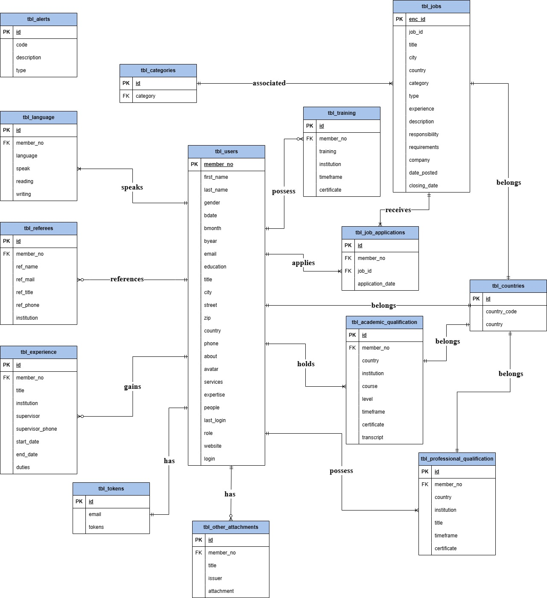
DATABASE Design - ERD

Slide 8
Database Design – Data Dictionary
Entity | Attribute | Datatype | Required (Y/N) | PK/FK
Tbl_academic_qualification | id member_no country institution course level timeframe certificate Transcript | INT VARCHAR(255) VARCHAR(255) VARCHAR(255) VARCHAR(255) VARCHAR(255) VARCHAR(255) LONGBLOB LONGBLOB | Y Y Y Y Y Y Y Y N | PK FK
Tbl_alerts | id code description Type | INT(255) VARCHAR(255) VARCHAR(255) VARCHAR(255) | Y Y Y Y | PK FK FK
Tbl_category | id Category | INT(255) VARCHAR(255) | Y Y | PK FK
Tbl_countries | id country_code country_name | INT(11) VARCHAR(2) VARCHAR(100) | Y Y Y | PK
Entity | Attribute | Datatype | Required (Y/N) | PK/FK
Tbl_experience | id member_no title institution supervisor supervisor_phone start_date end_date duties | INT(255) VARCHAR(255) VARCHAR(255) VARCHAR(255) VARCHAR(255) VARCHAR(255) VARCHAR(255) VARCHAR(255) LONG TEXT | Y Y Y Y N N Y Y N | PK FK
Tbl_job_applications | Id member_no job_id application_date | INT(255) VARCHAR(255) VARCHAR(255) VARCHAR(255) | Y Y Y Y | PK FK FK
Tbl_jobs | job_id Title City Country Type experience description responsibility requirements company date_posted closing_date enc_id | VARCHAR(255) VARCHAR(255) VARCHAR(255) VARCHAR(255) VARCHAR(255) VARCHAR(255) Long text Long text Log text VARCHAR(255) VARCHAR(255) VARCHAR(255) INT(255) | Y Y Y Y Y N Y Y Y Y Y Y Y | PK

Slide 9
Database Design – Data Dictionary
Entity | Attribute | Datatype | Required (Y/N) | PK/FK
Tbl_language | Id member_No Language Speak Reading writing | INT(225) VARCHAR(225) VARCHAR(225) VARCHAR(225) VARCHAR(225) VARCHAR(225) | Y Y Y Y Y Y | PK FK
Tbl_other_attachments | Id member_no Title Issuer attachment | INT(255) VARCHAR(255) VARCHAR(255) VARCHAR(255) LNGBLOB | Y Y Y Y Y | PK FK
Tbl_professional_qualification | Id member_No Country Institution Title Timeframe certificate | INT(255) VARCHAR(255) VARCHAR(255) VARCHAR(255) VARCHAR(255) VARCHAR(255) LONGBLOB | Y Y Y Y Y Y Y | PK FK
Tbl_referees | Id member_No ref_name ref_mail ref_phone institution | INT(225) VARCHAR(225) VARCHAR(225) VARCHAR(225) VARCHAR(225) VARCHAR(225) | Y Y Y Y N N | PK FK
Tbl_tokens | Id Email token | INT(255) VARCHAR(255) VARCHAR(255) | Y Y Y | PK FK
Entity | Attribute | Datatype | Required (Y/N) | PK/FK
Tbl_training | Id member_no Training Institution Timeframe certificate | INT(255) VARCHAR(255) VARCHAR(255) VARCHAR(255) VARCHAR(255) LONGBLOB | Y Y Y N Y Y | PK FK
Tbl_users | member_no first_name Last_name Gender Bdate Month Byear Email Education Title City Street Zip Country Phone About Avatar Services Expertise People Last_login Role Website Login | INT(255) VARCHAR(255) VARCHAR(255) VARCHAR(255) VARCHAR(255) VARCHAR(255) VARCHAR(255) VARCHAR(255) VARCHAR(255) VARCHAR(255) VARCHAR(255) VARCHAR(255) VARCHAR(255) VARCHAR(255) VARCHAR(255) LONTEXT LONGBLOB LONGTEXT LONGTEXT VARCHAR(255) VARCHAR(255) VARCHAR(255) VARCHAR(255) VARCHAR(255) | Y N N N N N N Y N N N N N N N N N N N N Y Y N Y | PK FK

Slide 10
Server Design
Server Configuration
Used XAAMP to integrate MYSQL server with PHP/HTML pages.
Hosted on localhost for alpha testing
Website Skeleton
PHP pages were designed and organized into categorical folders for better access.
Database Integration
MYSQL server hosted through XAAMP for easy integration
MY_SQLI extension from PHP is used for quarrying the database

Slide 11
User Interface
- - Live Demo - -

Slide 12

Yours Truly
Nagendra Reddy Palugulla – 2250572
Harikesh Govindaiahgari – 2248386
Tharun Pasham – 2256307
Sai Divya Sree Nagapudi Venugopal – 2303233
Abhigna Sowgandhika Vadlamudi – 2268166
Ahmed Hussain Syed - 2273473
Sheema Anush - 2303265

Slide 13

Q&A

